Slide 1
Iteration - While

Slide 2
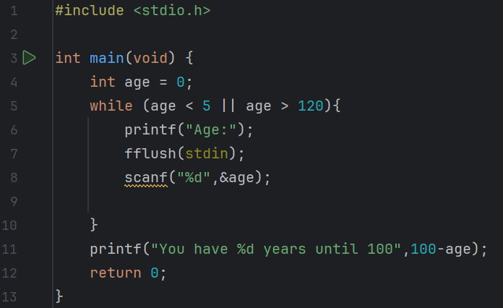
Predict
What do you think this code does?
Sets initial variable age as 0. While the variable age is lower than 5 or over 120, the user will get asked their age. If they have input a number in between these, the while loop ends and it prints how many years they have until they are 100.

Slide 3
Run
Download the code from Github and run it!
What does the code do?
Sets initial variable age as 0. While the variable age is lower than 5 or over 120, the user will get asked their age. If they have input a number in between these, the while loop ends and it prints how many years they have until they are 100.
Does this match your prediction?
Yes.

Slide 4
Investigate
Investigation Activities
What is the name of the variable being used? age What data type does it hold? Integers, whole numbers What does || mean in line 5?means “or”, executed if one of the conditions or both are met What happens if you enter invalid data? It asks you to enter your age again

Slide 5
Modify
Modification Activities
Modify the program to accept ages from 0 to 115. Modify the program so that it takes their age in years and then displays how many days old the person is, ignoring leap years. Modify the program so that it takes their age in years and then displays how many days old the person is, including leap years.

Slide 6
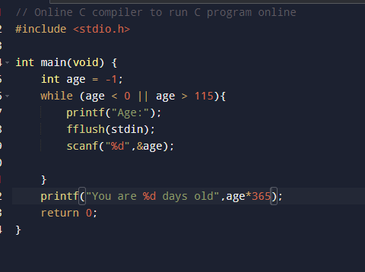
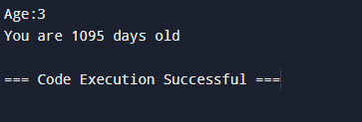
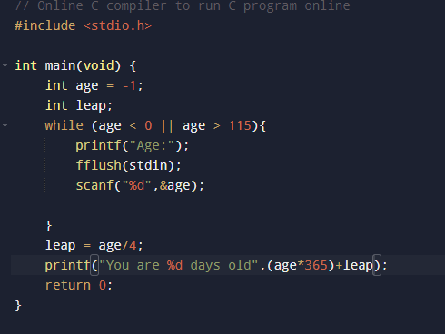
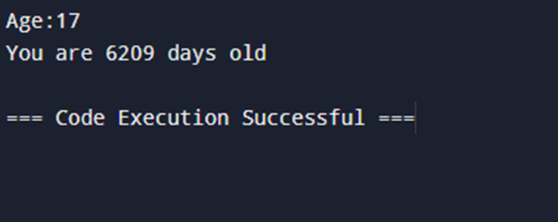
Without leap year
With leap year

Slide 7
Make
Make Activities
Write a program that gives the user 5 chances to guess a number and tells them when they are correct. Requirements Create a variable to hold a randomly generated number Allow the user to input their guess Check and display whether the user’s guess is correct, too high or too low and give suitable feedback The loop should end when they guess correctly , and output a ‘Well done’ message OR if they have had 5 guesses, should end the loop and output “You lose”

Slide 8
